Slide 1

Vector-Valued Functions, Space Curves, Arc Length and Curvature
These topics form an important bridge between vector algebra and multivariable calculus. They allow us to describe the motion of an object in three-dimensional space and analyze not only where it is, but also how fast it moves, in which direction it moves, how far it travels, and how sharply its path bends.
A vector-valued function is a mathematical rule that takes a real number input (like time t) and outputs a vector. It maps a single-variable parameter to multi-dimensional coordinates, defining paths like lines, circles, or helixes in 2D or 3D space.

Slide 2
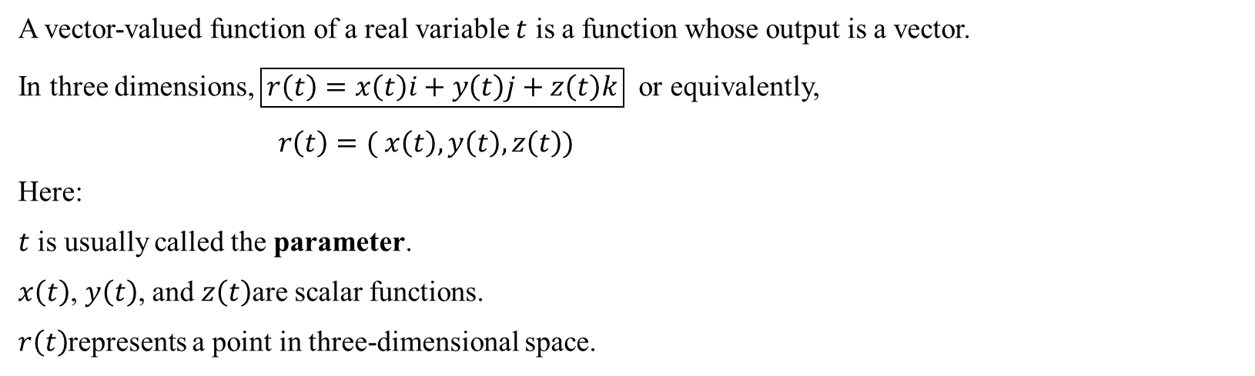
Vector-Valued Functions
A vector-valued function of a real variable $t$ is a function whose output is a vector.
In three dimensions, $\boxed{r\left(t\right)=x\left(t\right)i+y\left(t\right)j+z\left(t\right)k}$ or equivalently,
$r\left(t\right)=( x\left(t\right), y\left(t\right), z\left(t\right))$
Here:
$t$ is usually called the parameter.
$x\left(t\right)$, $y\left(t\right)$, and $z\left(t\right)$are scalar functions.
$r\left(t\right)$represents a point in three-dimensional space.

Slide 3
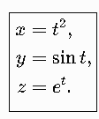
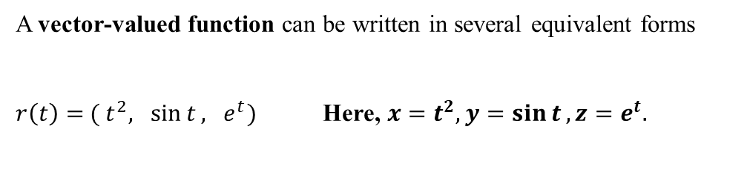
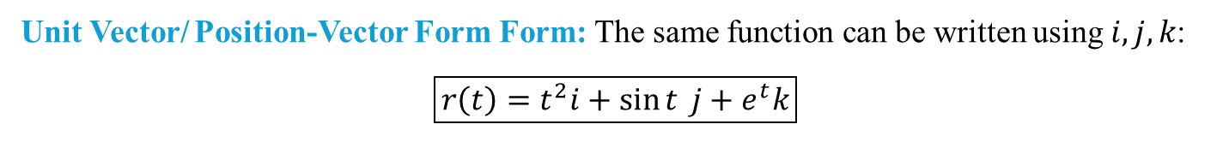
Vector-Valued Functions
A vector-valued function can be written in several equivalent forms
$r\left(t\right)={ ( t}^{2}, \sin{t}, e^{t})$ Here, $x=t^{2}, y=\sin{t}, z=e^{t}.$
Unit Vector/ Position-Vector Form Form: The same function can be written using $i,j,k$:
$$\boxed{r\left(t\right)=t^{2}i+\sin{t} j+e^{t}k}$$
Parametric Form

Slide 4
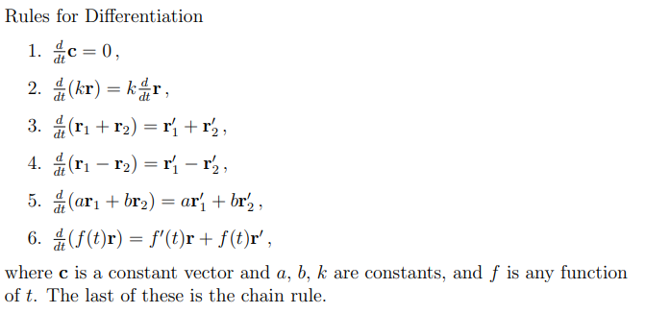
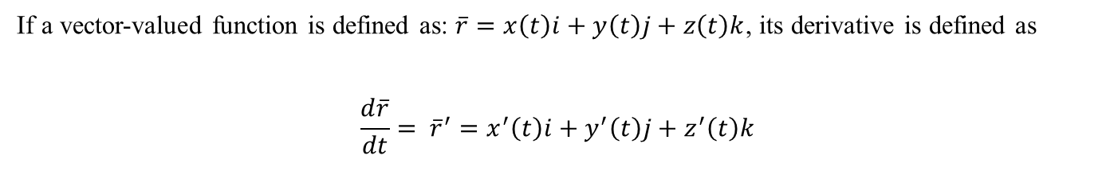
Differentiation of vector valued function:
The derivative of a vector-valued function is found by differentiating each of its component functions individually with respect to the parameter
If a vector-valued function is defined as: $\overline{r}=x\left(t\right)i+y\left(t\right)j+z\left(t\right)k$, its derivative is defined as
$$\frac{d\overline{r}}{dt}= {\overline{r}}^{′}=x^{′}\left(t\right)i+y^{′}\left(t\right)j+z^{′}\left(t\right)k$$

Slide 5



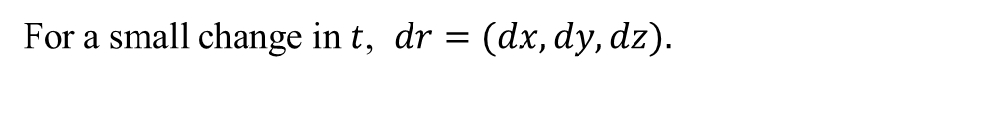
Arc Length of a Vector-Valued Space Curve
The arc length of a curve is the actual distance measured along the curve between two points. For a straight line, we can use the distance formula. But for a curved path, the distance is not simply the straight-line distance between the endpoints. Arc length gives us the actual length of the curved path.
Consider a space curve
For a small change in $t$, $dr=(dx, dy, dz).$
The small distance along the curve is
Therefore, Arc length

Slide 6
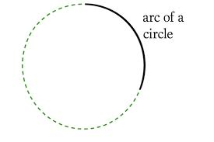
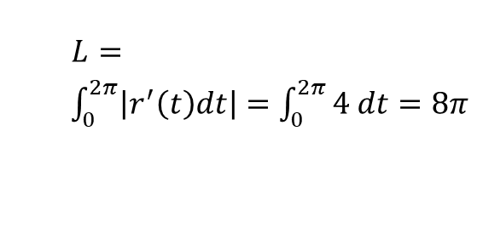

Arc Length of a Vector-Valued Space Curve
Problem 1 Circular Motion $r\left(t\right)=\left( 4cost, 4 sint \right)$ , $0≤t≤2π$
$$r^{′}\left(t\right)=\left( −4sint, 4cost \right)$$
$L= \int_{0}^{2π}{\left|r^{′}\left(t\right)dt\right|=\int_{0}^{2π}{4 dt=8π }}$

Slide 7
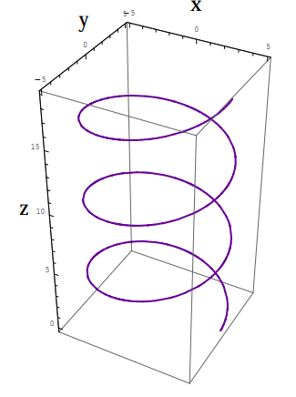
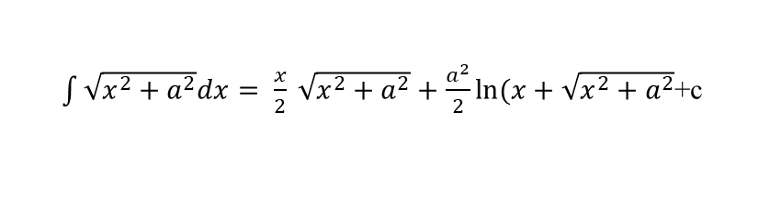
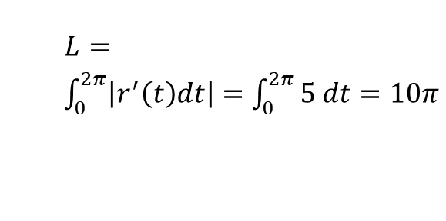

Arc Length of a Vector-Valued Space Curve
Helix $r\left(t\right)=\left( 3cost, 3 sint, 4t \right)$ , $0≤t≤2π$
$$r^{′}\left(t\right)=\left( −3sint, 3 cost, 4 \right)$$
$L= \int_{0}^{2π}{\left|r^{′}\left(t\right)dt\right|=\int_{0}^{2π}{5 dt=10π }}$
$\int{\sqrt{x^{2}+a^{2}}dx= \frac{x}{2}} \sqrt{x^{2}+a^{2}}+\frac{a^{2}}{2}ln⁡(x+\sqrt{x^{2}+a^{2}}$+c

